Slide 1


SPH simulation of vertical high-speed jet flow from a circular nozzle with stagnation pressures prediction
SPHERIC 2019
Exeter, England – 25th – 27th June
MOREIRA*, P. Manso**, D. VIOLEAU*** AND F. TAVEIRA-PINTO*
*University of Porto – Faculty of Engineering, Porto, Portugal
** Ecole Polytechnique Fédérale de Lausanne (EPFL), Lausanne, Switzerlan
***EDF R&D / LNHE & Université Paris-Est, Saint-Venant Hydraulics Laboratory (ENPC, EDF R&D, CEREMA), Chatou, France

Slide 2
CONTENTS
MOTIVATION
STUDY GOALS
EXPERIMENTAL BACKGROUND
3D NUMERICAL MODEL
RESOLUTION SENSITIVITY ANALYSIS
RESULTS
CONCLUSION

Slide 3
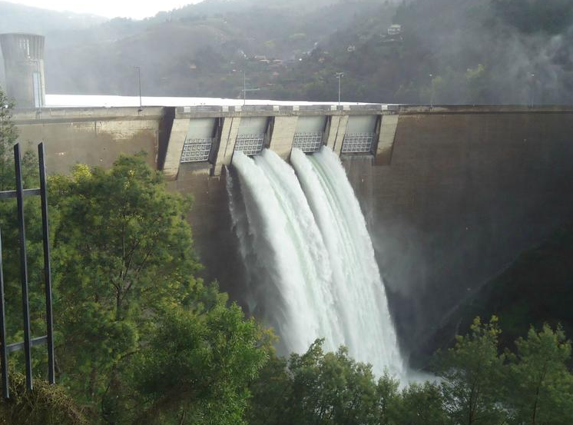
MOTIVATION
Why this topic?
High-velocity plunging jets can be found in many dams
There is a need to quantify the HYDRODYNAMIC LOADING produced by the jet impact
Caniçada dam, Portugal
Unrevised probable maximum floods
Increased risk of dam overtopping
+
Climate change
=
MOTIVATION
STUDY GOALS
EXPERIMENTAL…
4
3D NUM..
GPUSPH FORMULATIONS
RESULTS
CONCLUSION
1
2
3
5
6
7

Slide 4
STUDY GOALS
To understand the physics of the diffusion of jets in pools for various pool depths, as such analysis is hampered in a physical model due to the high ratio of entrained air;
To provide quantification of the pressures acting on the pool bottom;
To contribute to the continuous verification and validation of the SPH method.
MOTIVATION
STUDY GOALS
EXPERIMENTAL…
4
3D NUM..
GPUSPH FORMULATIONS
RESULTS
CONCLUSION
1
2
3
5
6
7

Slide 5
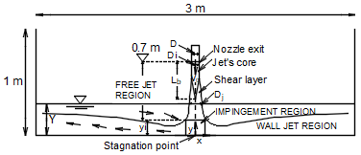
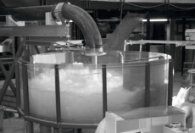
EXPERIMENTAL BACKGROUND
Experiments previously done at EPFL
Manso (2006) studied jets with an exit velocity of ~29.5 m/s (Q=120 L/s) impinging into a still water pool of varying water depths, Y
Pressures were measured at the bottom of the pool
MOTIVATION
STUDY GOALS
EXPERIMENTAL…
4
3D NUM..
GPUSPH FORMULATIONS
RESULTS
CONCLUSION
1
2
3
5
6
7

Slide 6
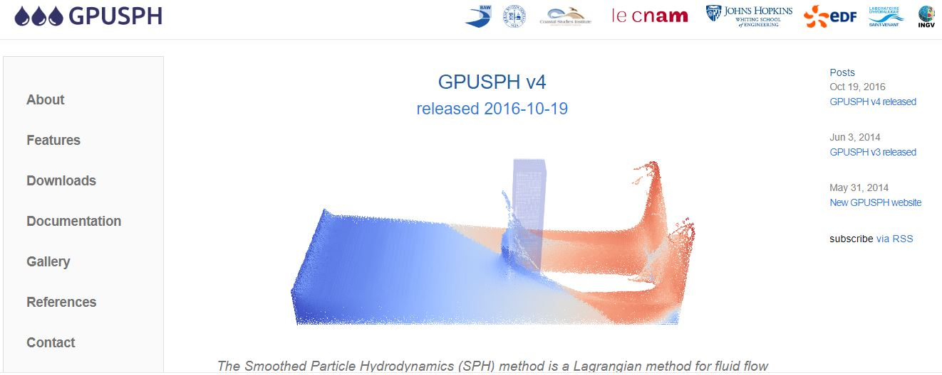
3D NUMERICAL MODEL
Formulations used in GPUSPH 4.1:
USAW – boundary conditions (Ferrand et al. 2012)
Open-boundaries (Ferrand et al., 2017); a velocity driven (inlet) and two pressure driven (outlets, to mimic the weirs existent in the physical model)
Standard k-ε turbulence model
Time-step varied (maximum CFL number of 0.3 – stability condition)
Quintic Wendland kernel
(same dimensions as the physical model)
Tube diameter, D: 0.072 m (not modelled)
Pool diameter: 3 m
Pool water depth, Y: 0.2 m
MOTIVATION
STUDY GOALS
EXPERIMENTAL…
4
3D NUM..
GPUSPH FORMULATIONS
RESULTS
CONCLUSION
1
2
3
5
6
7

Slide 7

3D NUMERICAL MODEL
On June 13th 2019!
New features:
possibility to create simulation scenarios using the SALOME open-source platform;
Hu & Adams formulation for multi-fluid;
additional models for the viscous contribution to Navier–Stokes (Monaghan, Español & Revenga);
more sophisticated viscous model options, including turbulence, averaging operator and fluid rheology;
non-Newtonian rheology models including Bingham, granular material, Herschel–Bulkley and DeKee & Turcotte;
man-machine interface;
experimental support for initial repacking phase.
The GPUSPH Discourse group is now available
visit www.gpusph.org & www.gpusph.discourse.group
MOTIVATION
STUDY GOALS
EXPERIMENTAL…
4
3D NUM..
GPUSPH FORMULATIONS
RESULTS
CONCLUSION
1
2
3
5
6
7

Slide 8
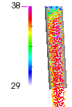
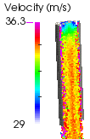
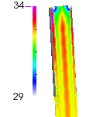
RESOLUTION SENSITIVITY ANALISYS
Initial simulations showed that the flow inside the nozzle was too much accelerated (!?)
Thus the exit velocity wasn’t accurate…
D/dp = 7,1
D/dp = 17,2
D/dp = 34,1
Using a variable resolution approach would be ideal (higher resolution in the noozle and lower resolution in the pool), but this is not yet available in GPUSPH.
D/dp = nozzle diameter/ particle diameter
MOTIVATION
STUDY GOALS
EXPERIMENTAL…
4
3D NUM..
RESOLUTION SENSITIVITY..
RESULTS
CONCLUSION
1
2
3
5
6
7

Slide 9
RESOLUTION SENSITIVITY ANALISYS
The adopted solution was to impose a logaritmic profile at the nozzle’s exit and to not simulate the nozzle itself
Velocity profile along the nozzle diameter at the exit section
In terms of the velocity profile shape, modeling the nozzle is indeed more accurate, but it demands for an impractically high number of particles
MOTIVATION
STUDY GOALS
EXPERIMENTAL…
4
3D NUM..
GPUSPH FORMULATIONS
RESULTS
CONCLUSION
1
2
3
5
6
7

Slide 10
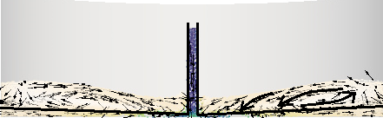
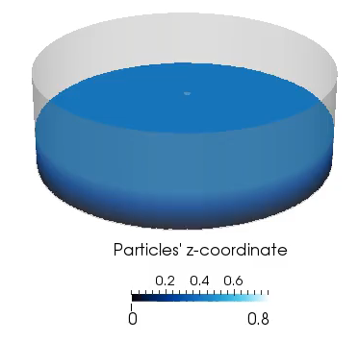
RESULTS
Qualitative validation
Photo from Lopes (2005)
10-s simulation
MOTIVATION
STUDY GOALS
EXPERIMENTAL…
4
3D NUM..
GPUSPH FORMULATIONS
RESULTS
CONCLUSION
1
2
3
5
6
7
Notes:
We made considerations on the impact of analysing only 10s of simulations in our paper 3 (under review in JHR)

Slide 11
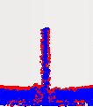
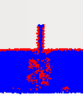
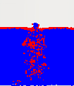
RESULTS
Quantitative validation
Pressure at the stagnation point for Y/D= 2.8; Y/D= 5.6; Y/D= 8.3
Photo from Lopes (2005)
Y/D= 2.8
Y/D= 5.6
Y/D= 8.3
Free-surface particles in red detected following a simplification of the technique proposed by Marrone, Colagrossi, Le Touzé & Graziani, (2010)
Consistent with the air entrainment visible in the experiments
Results on the SPHERIC’s paper - Y/D= 2.8
MOTIVATION
STUDY GOALS
EXPERIMENTAL…
4
3D NUM..
GPUSPH FORMULATIONS
RESULTS
CONCLUSION
1
2
3
5
6
7

Slide 12
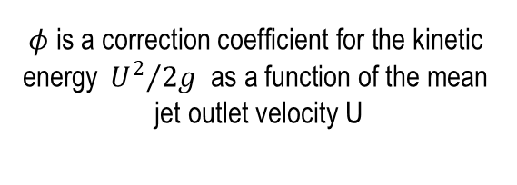
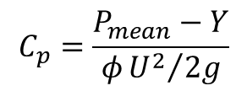
RESULTS
Quantitative validation
Pressure at the stagnation point (Y/D= 2.8; Y/D= 4.2; Y/D= 5.6; Y/D= 7.2 Y/D= 8.3; Y/D= 9.7)
6 SPH simulations(2005)
$$C_{p}=\frac{P_{mean}−Y}{φ{U^{2}}/{2g}}$$
$$φ \text{is} \text{a} \text{correction} \text{coefficient} \text{for} \text{the} \text{kinetic} \text{energy} {U^{2}}/{2g} \text{as} \text{a} \text{function} \text{of} \text{the} \text{mean} \text{jet} \text{outlet} \text{velocity} \text{U}$$
MOTIVATION
STUDY GOALS
EXPERIMENTAL…
4
3D NUM..
GPUSPH FORMULATIONS
RESULTS
CONCLUSION
1
2
3
5
6
7

Slide 13
CONCLUSIONS
A very fine particle resolution is needed to accurately simulate the confined flow
Qualitative results are sound
Mean and maximum pressures near the stagnation point were computed with a relative error of about 22% and 1% (Y/D= 2.8)
Accuracy of the mean pressure’s prediction was likely influenced by the lack of air phase modelling
Further analysis will include:
- centerline velocity decay along the jet
- radial pressures’ distribution
MOTIVATION
STUDY GOALS
EXPERIMENTAL…
4
3D NUM..
GPUSPH FORMULATIONS
RESULTS
CONCLUSION
1
2
3
5
6
7

Slide 14


THANK YOU!
QUESTIONS AND COMMENTS CAN BE SEND TO: up200706631@fe.up.pt

