Slide 1
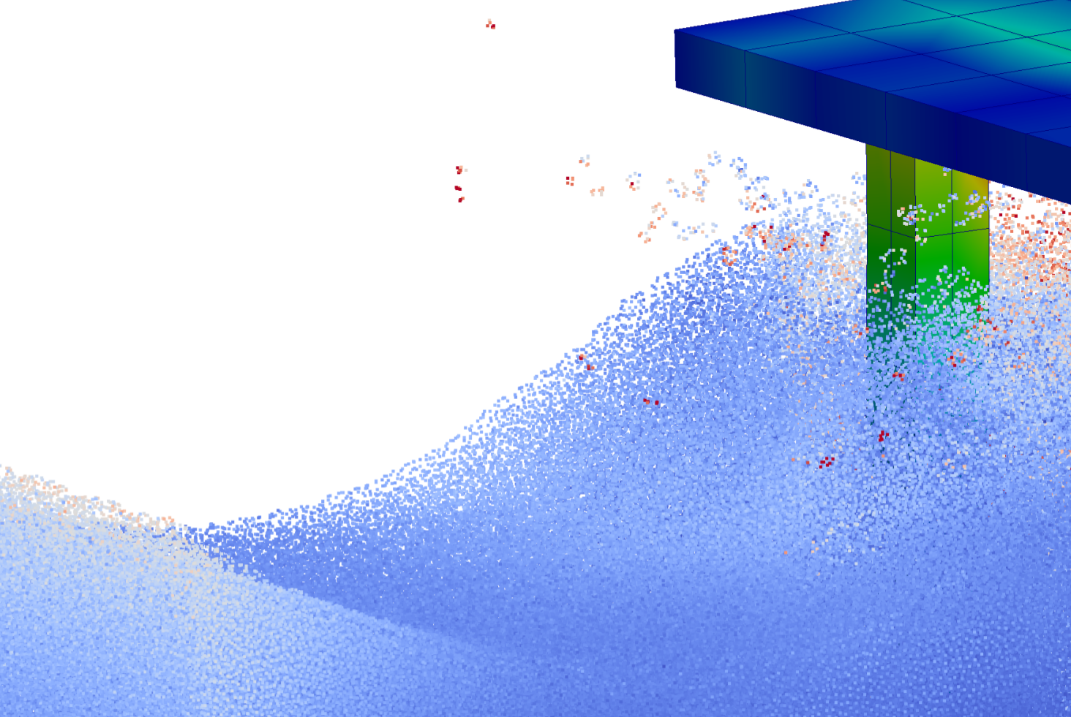

Coupling SPH and FEM analysis in GPUSPH for the study and design of offshore platforms
Vito Zago
R. A. Dalrymple
G. Bilotta, A. Cappello
G. Ganci, C. Del Negro
A. Hérault
N. Al Mashaan

Slide 2

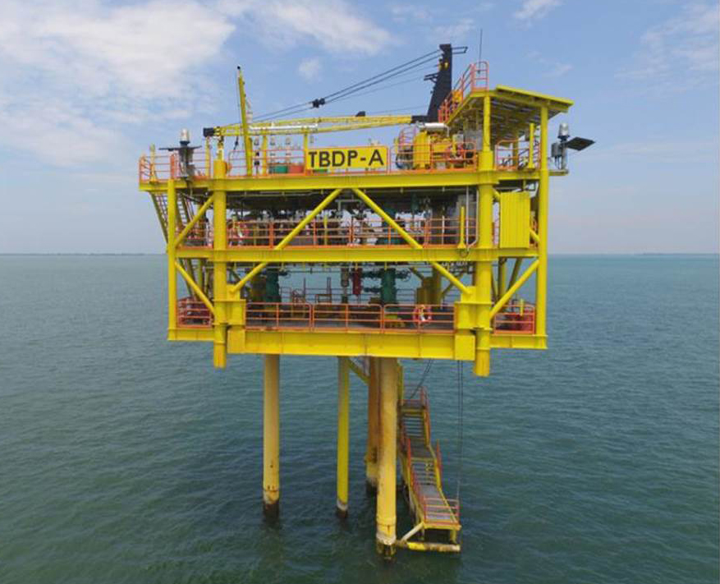
The purpose
Numerical simulation of offshore structures and sea waves
    offshore platforms;
    wind turbines;
    wave energy converters;
Understanding the global behavior of the structure, the interaction with water waves, and the distribution of strain and stress.
Offer a simple way to setup the numerical problem and apply changes.
Notes:
This work regards the coupling of sph and fem methods for the numerical simulation of offshore structures in their interaction with sea waves, for exapmple…
We are talking of simulations where we are interested in the global behavior of the structure, for example the distribution of strain and stresses, the vibration modes and so on
That is some information useful for the design and study of the structure
And we want to make the coupled sph-fem model easy to setup and modify

Slide 3


SPH and FEM
Validated for simulation of breaking and non-breaking waves
Several formulations
Runs on GPU with multi-device multi-node capabilities
Multi-physics simulation engine
Already coupled to GPUSPH for rigid bodies
Coupled Finite Elements Analysis for elastic bodies run on multi-core CPU
Notes:
So, to manage the SPH and the FEM analysis we are using respectively GPUSPH and Project Chrono
Yesterday we saw the presentation about all the features that GPUSPH offers, and of course the implementation on gpu and the good performances is important,
but what is also important here is that it has been validated for the simulation of ….
On the other hand..

Slide 4
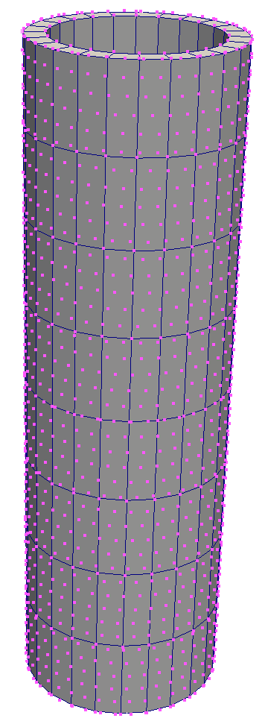
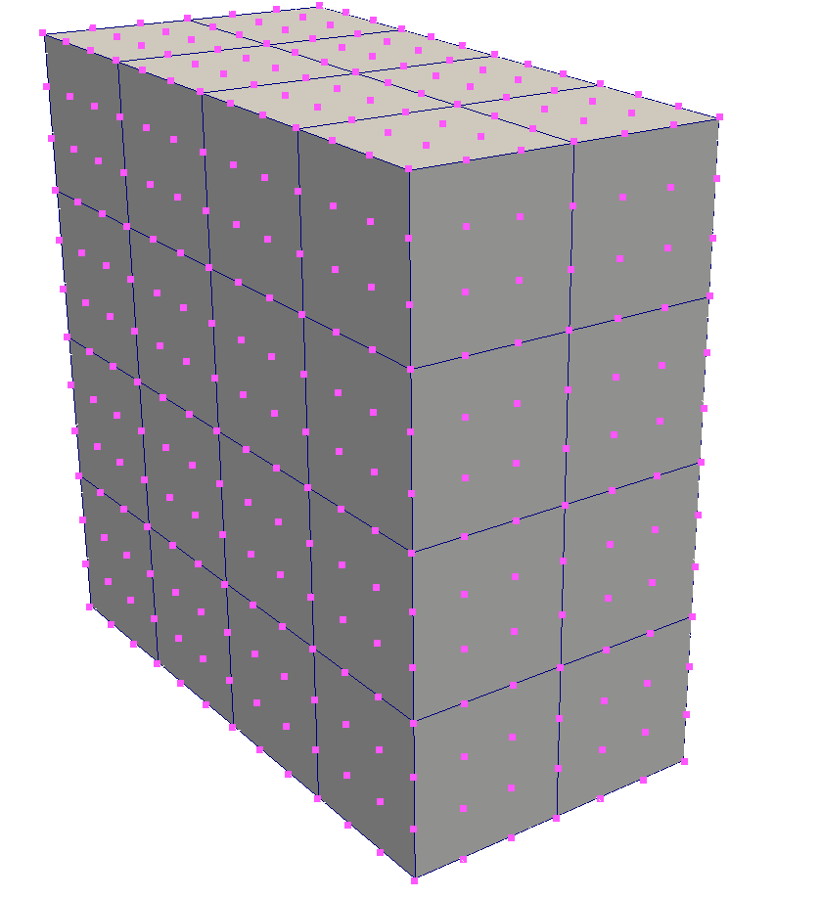
Setup of the problem
We can upload a mesh for FEM or use the GPUSPH tools to create one
Geometries have their associated meshes with their own number of elements
The FEM model is built simultaneously with the SPH model when starting the simulation
Prescribed strong matching between particles and elements
Easy to change: we don’t need to rebuild and upload a mesh
Good interaction with the SPH setup (e.g. Erasing fluid where pillars are)
Good treatment of multi-layer boundary models
Notes:
A typical approach is to build a mesh with a tool
And then associate a sph description of the geometry

Slide 5
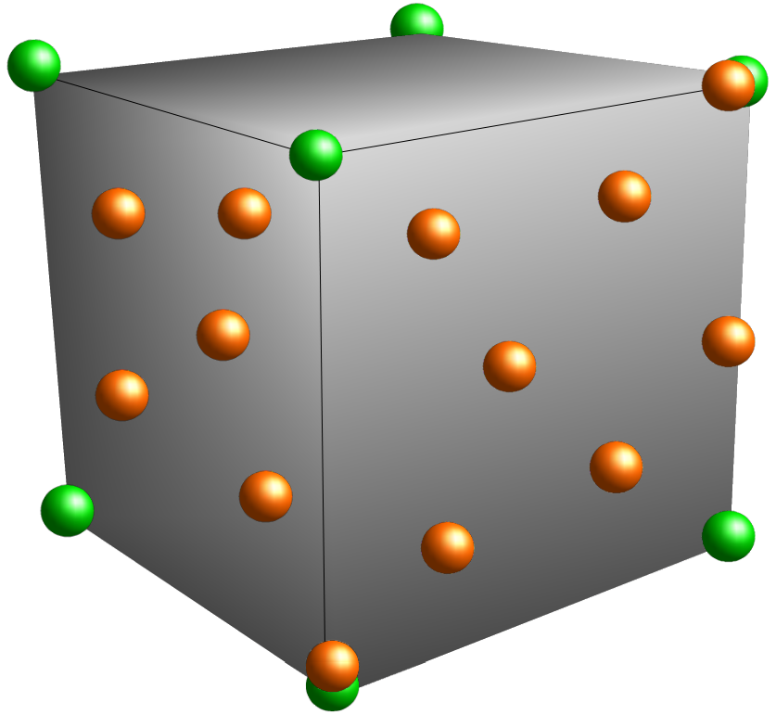
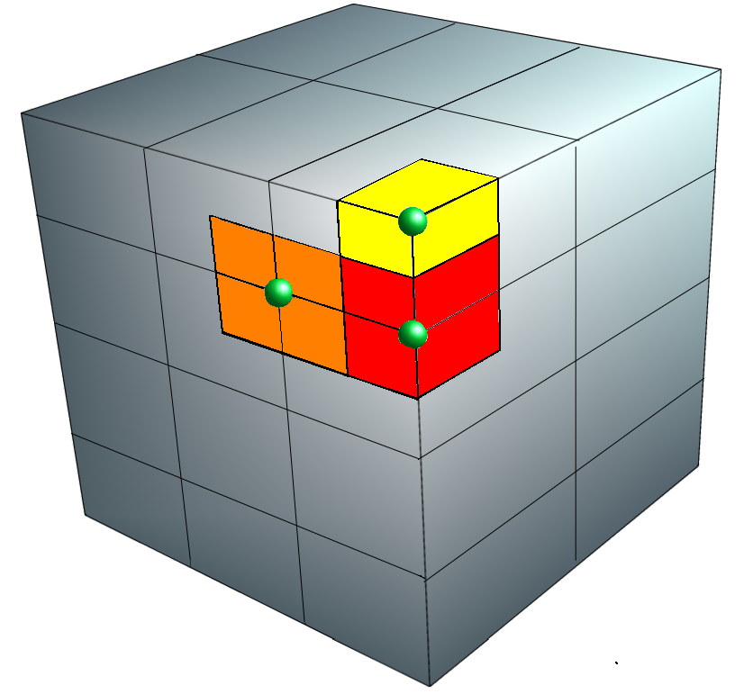

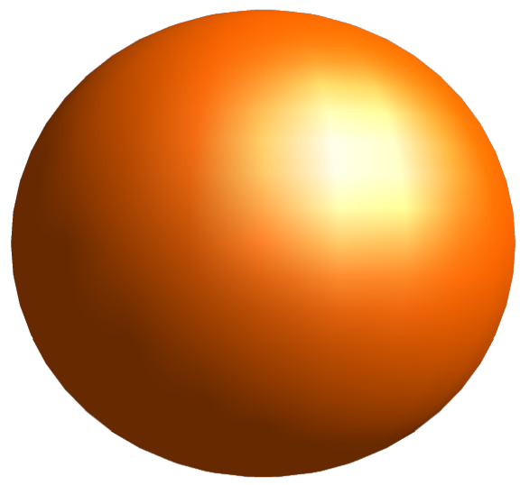
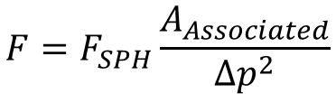
Coupling between SPH and FEM
FEM element and associated SPH particles
FEM mesh and areas associated to nodes
FEM Nodes: calculate SPH forces but are invisible to SPH particles
Forces exerted by fluid are obtained as SPH
forces extended to the associated element
Surface
Deformable particles: Implement the SPH
boundary and move according to FEM
nodes; may coincide with nodes.
$$F=F_{SPH}\frac{A_{Associated}}{{∆p}^{2}}$$

Slide 6
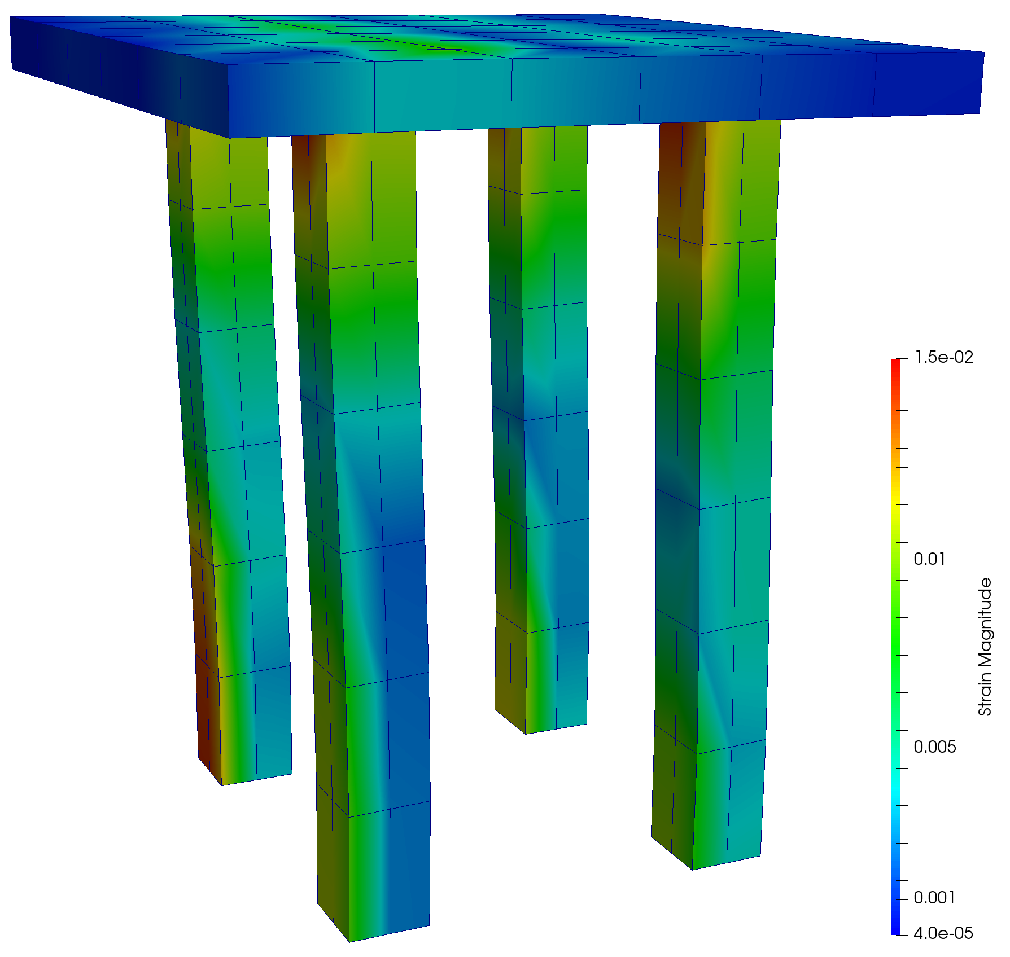
Joining FEM meshes
Geometries can be used to assemble more complex structures
Geometry 1
Joint
Geometry 2
Joint elements: box-shaped rigid bodies that embed all the nodes that fall inside. Elements do not have to match
Joints have their own dynamical properties.
Notes:
Each geometry can have a FEM mesh associated and can be used by itself (we saw an example of a floating deformable box)
But our intention is to use those elements to assemble more complex structures
Say the joint has dynamics

Slide 7
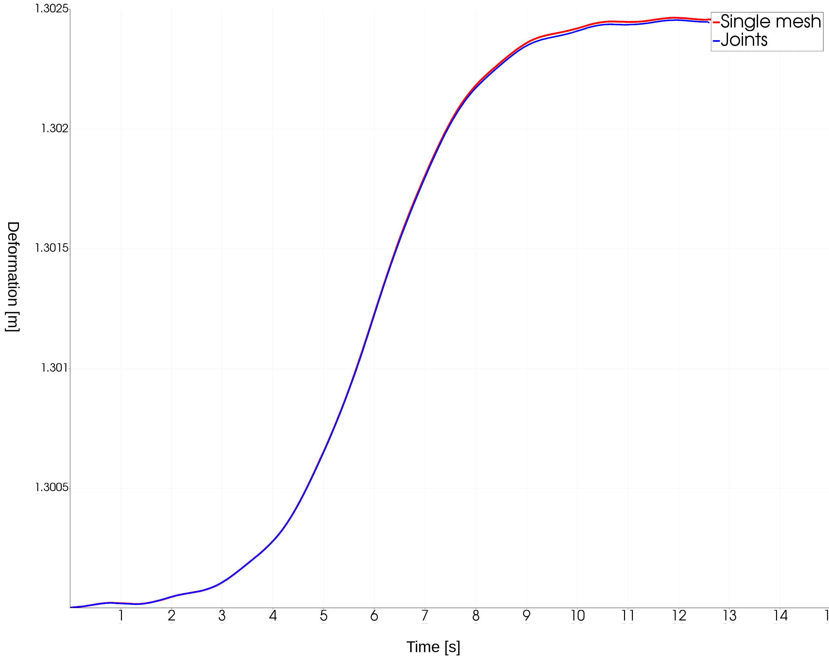
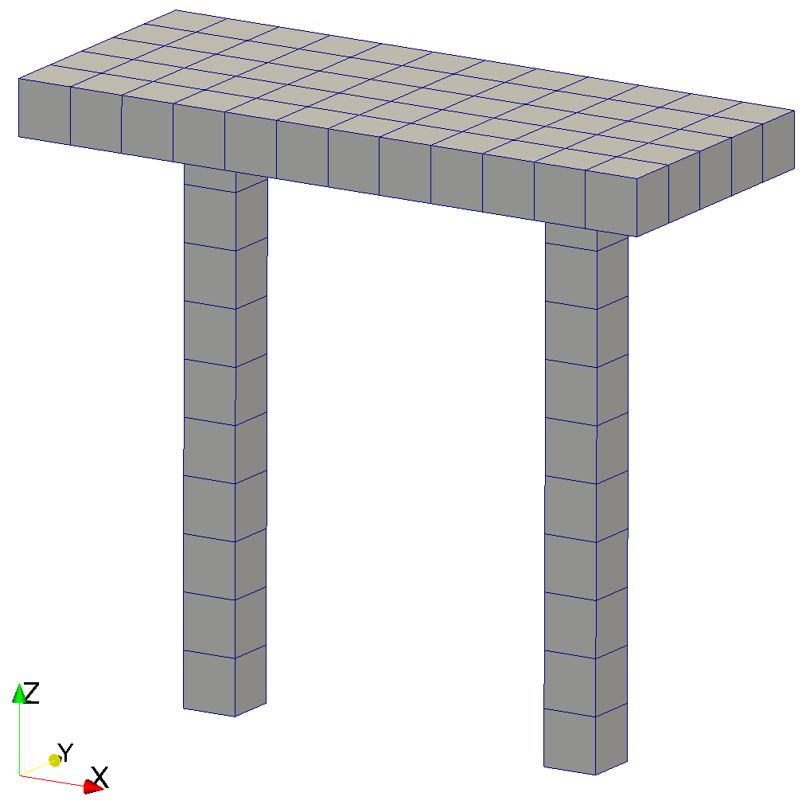
Validation 1: testing joint elements
To test the quality of a mesh built using joints we compare:
Structure modeled with a single mesh
Same structure obtained using joints
F
The two simulations differ by the 0.22% on
the final deformation.
Notes:
Talk about the joint

Slide 8
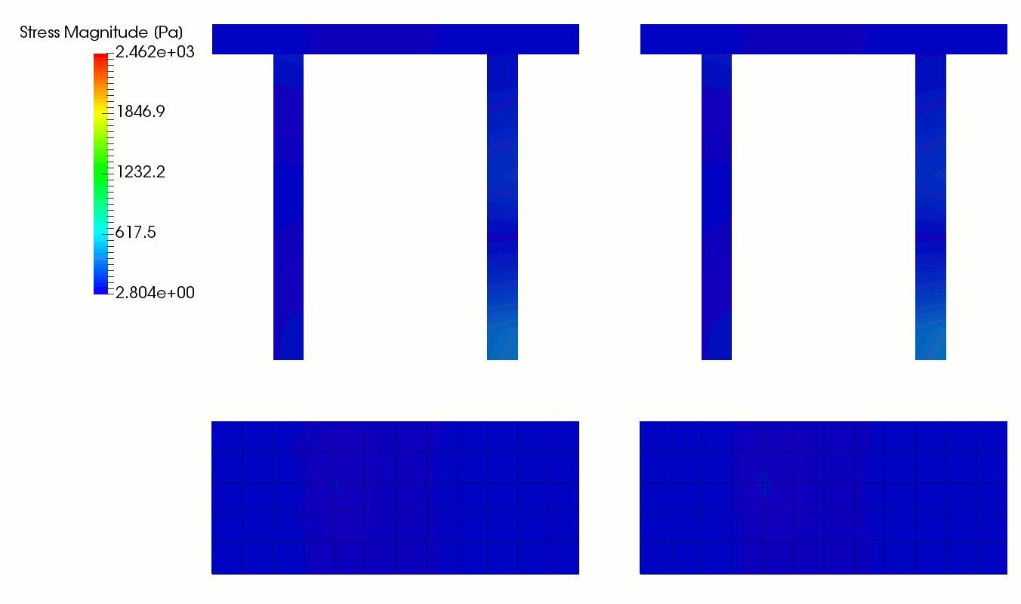
Validation 1: testing joint elements
Single mesh
Joints
Top view

Slide 9
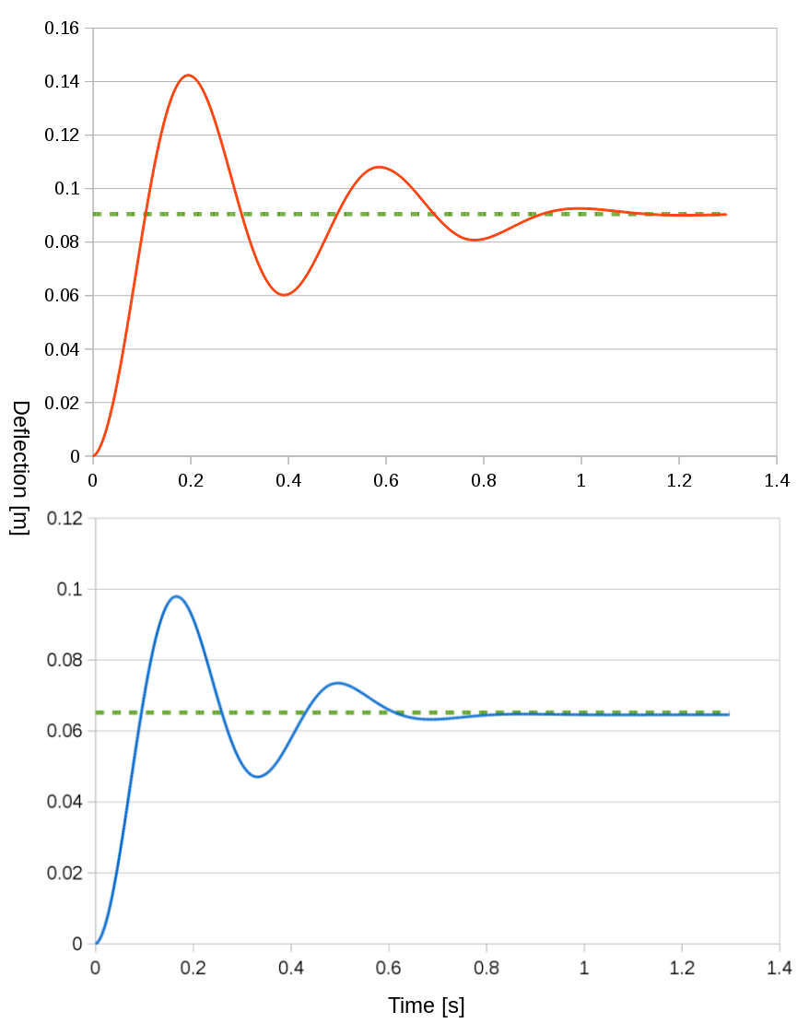
Validation 2: Cylindrical hollow pipe
We build pipes using a closed grid of squared elements
E = 500 MPa
Δx_{simulated} = 0.0905 m vs Δx_{theoretical} = 0.0913 m
Ts = 0.391s vs Tt = 0.391 s
F
Data:
L = 3m
R = 0.1 m
Thickness = 3 mm
Mesh: shell element in a 10 x 5 grid
E = 700 MPa
Δx_{simulated} = 0.0646 m vs Δx_{theoretical} =0.0652 m
Ts = 0.331s vs Tt = 0.3304 s
Notes:
We are building geometries in this way because we want to couple them with sph. Let us see if this is consistent under the FEM point of view.
Calibrating the number of elements we get this results

Slide 10
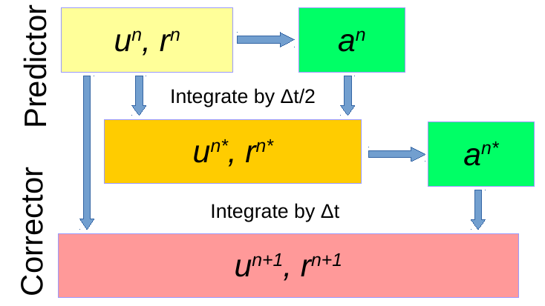
GPUSPH integration scheme
GPUSPH by default uses a second order predictor corrector
During the predictor phase the state is integrated by half step and the forces are computed
During the corrector phase, the old state is updated using the forces at half step
FEM can be executed either as predictor corrector, single step or every n iterations

Slide 11
FEM-SPH Integration step
CPU
GPU
Forces
Compute forces at step n
Predictor
Apply forces to nodes,
STORE initial node pos and vel
and compute FEA
Displacements
Integrate SPH, apply disp and vel
Compute forces at step n*
Forces
Apply forces to nodes,
RESTORE initial node pos and vel
and compute FEA
Displacements
Corrector
Integrate SPH, apply disp and vel

Slide 12
Data management
CPU and GPU exchange data up to 4 times per timestep→ transfers must be efficient
CPU
GPU
Arrays to store vel and pos
Nodes assoc. to deformable parts (#def parts x 4)
First def parts indices (# bodies)
First nodes indices (# bodies)
FEM System
(Project Chrono)
Pinned Buffer
(#nodes)
SPH System
All particles (included FEM nodes representative) have sequential index, and particles belonging to the same body are consecutive.
The nodes in the mesh are ordered so that the nodes belonging to an element can be obtained from a subset of them → less memory consumption on device
Notes:
To have efficient exchange we have a pinned buffer that is independent from the particles system:
Nodes are:
- consecutive
- always in the same place
To keep the connection between the two systems of arrays we use particles ids
When particles are created, they are assigned a sequential id.
Since all the nodes of a body are created sequentially, we only need to store the id of the first node and we can retrieve the position within the Pinned Buffer
A more expensive approach would be to store for each particle the id (every particle… not negligible)

Slide 13
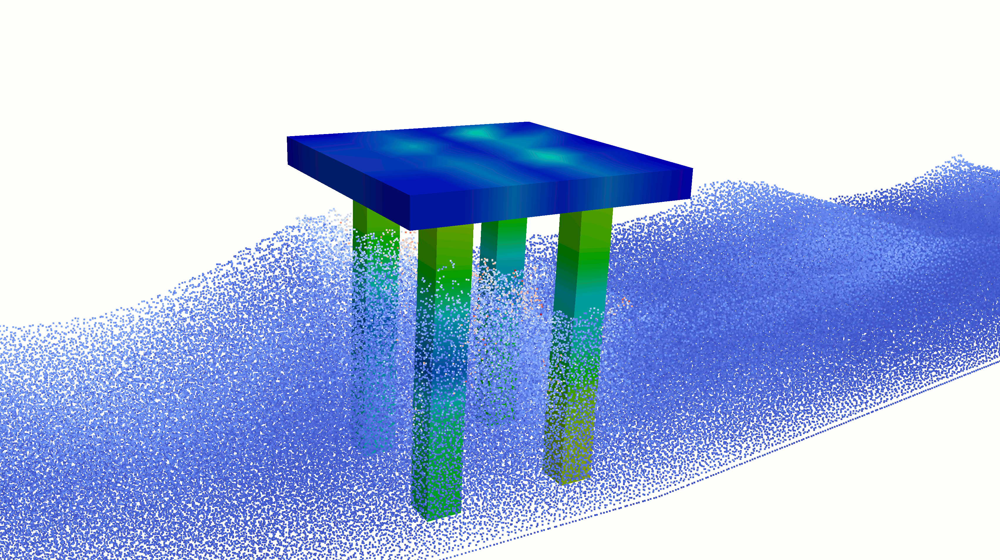
Simulation of a platform

Slide 14
Conclusions and future work
We added support for deformable bodies in GPUSPH
FEM meshes are created within GPUSPH and are automatically associated to their SPH description
Deformable bodies can be coupled to create more complex geometries
The coupled model will be adjusted and validated using a scaled physical model of a four-legged platform performed at Kuwait Institute for Scientific Research

